Slide 1



Microsoft Fabric
Sessão 7 Power BI e Microsoft Fabric tornado tudo mais simples e ágil
Armando Lacerda
Azure Cloud Architect Independent Consultant
Tiago Balabuch
Cloud Solutions Architect
Notes:
Both

Slide 2
Agenda
The story between Power BI and Fabric
How Fabric changed (evolved) Power BI
Demos

Slide 3








OneLake
Data Factory
Data Warehouse
Data Engineering
Data Science
Real Time Analytics
Data Activator
Power BI

Slide 4

Power BI

Slide 5



Slide 6








Synapse
+
Power BI
Data Integration
Spark Engines
Data
Warehouse
Observational Analytics
Data
Science
Business
Intelligence
Governance
Data Lake

Slide 7
“Direct Query Mode”
Parquet/Delta Lake
Data
Warehouse/
Lakehouse
Power BI
Analysis
Services
Scan
SQL
Queries
DAX
Queries
Tables
Reports
Slow, but real time
OneLake
“Import Mode”
Parquet/Delta Lake
Data
Warehouse/
Lakehouse
Power BI
Analysis
Services
DAX
Queries
Scan
Import
Latent & duplicative but fast
Tables
Reports
OneLake
Copy of
Tables

Slide 8
“Direct Lake”
Parquet/Delta Lake
Data
Warehouse/
Lakehouse
Power BI
Analysis
Services
Scan .
DAX
Queries
Perfect!
Tables
OneLake

Slide 9
Demos

Slide 10

Real-time analytics
One Logical Copy
By-default streaming ingestion
By-default indexing everything
Time and Hash based data partitioning
Native support for structured, semi-structured and free text data
In-place transformation

Slide 11
Real-time analytics
Tightly integrated with Fabric experiences
Mirroring to Lakehouse
By-default integration with event streaming sources
By-default integration with Power BI

Slide 12
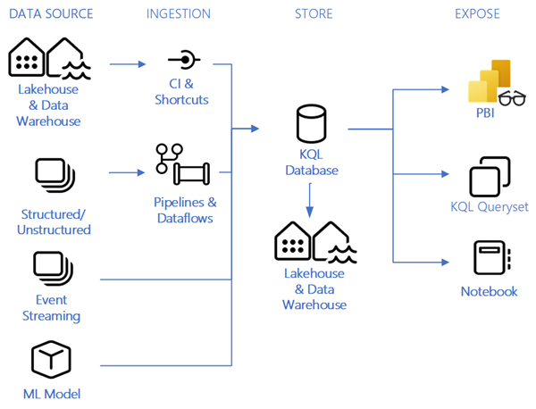
Real-time analytics

Slide 13
Demos

Slide 14
Nos vemos na próxima sessão.
Armando Lacerda
Azure Cloud Architect Independent Consultant
Tiago Balabuch
Cloud Solutions Architect
Notes:
Armando and Tiago

